Slide 1
TEACHER’S PERSONAL INFORMATION
Name: Nguyen Thanh Loan
Facebook: Loan Nguyễn Thanh
Mobile number: 0942 255 937
Email: loannguyenthanh1978@gmail.com

Slide 2
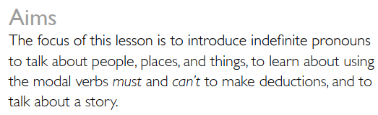
UNIT 8
JUST GO FOR IT

Slide 3


CONTENTS
Vocabulary: presentation, presentation equipment.
Grammar: something, everything, anything….; must, can’t for deduction; make/let/help; passive pronouns
Function: beginning and ending a talk.

Slide 4

LESSON 1
IS ANYONE HOME?
Would you like to spend a night in this house? Why?

Slide 5


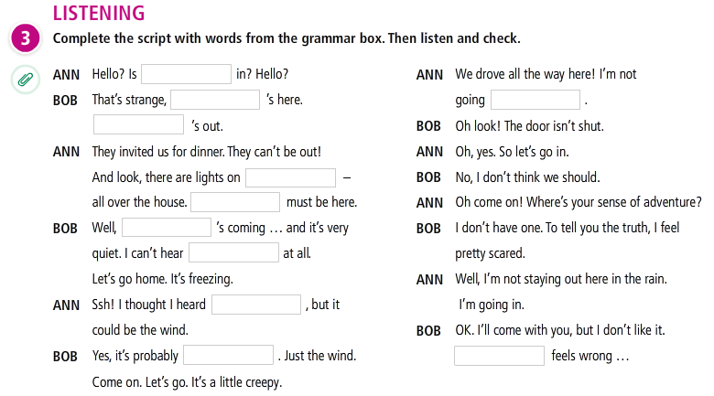
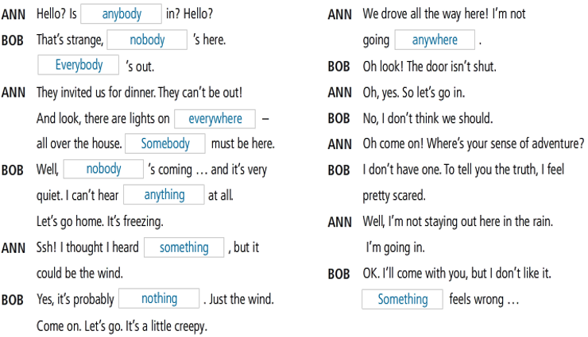
LESSON 1
IS ANYONE HOME?

Slide 6
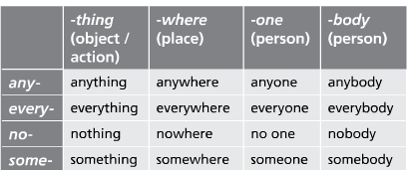
GRAMMAR
INDEFINITE PRONOUNS

Slide 7
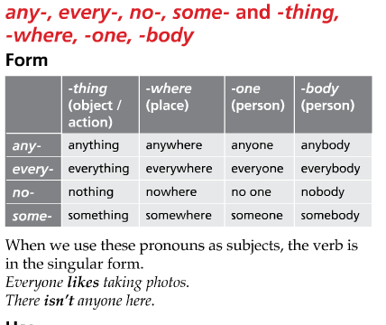
GRAMMAR

Slide 8
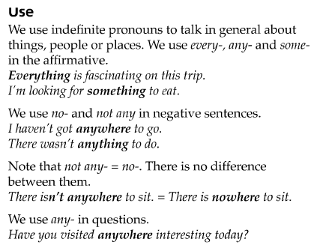
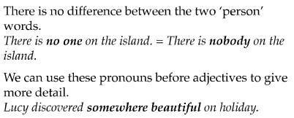
GRAMMAR
INDEFINITE PRONOUNS

Slide 9
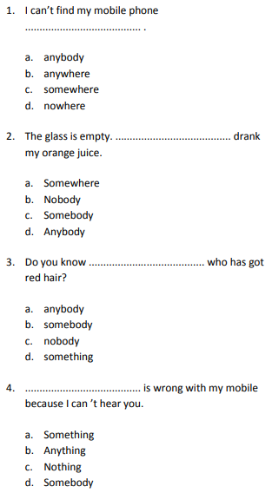
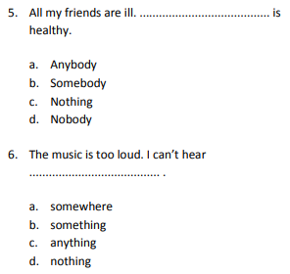
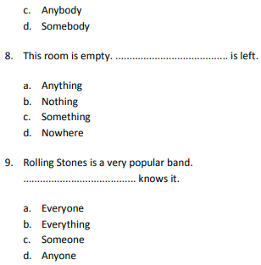
GRAMMAR
INDEFINITE PRONOUNS

Slide 10
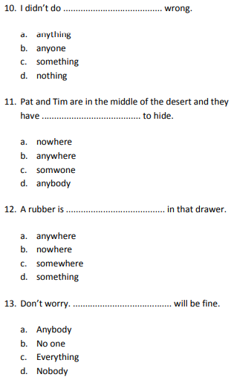
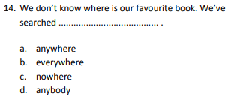
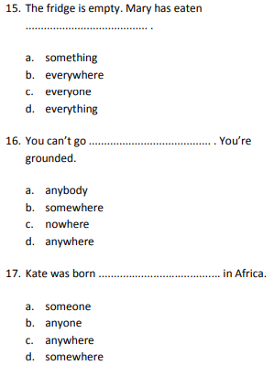
GRAMMAR
INDEFINITE PRONOUNS

Slide 11
Work in pairs
Each student has 4 minutes to memorize the grammar rules and the teacher will ask anyone to repeat and give an example.

Slide 12
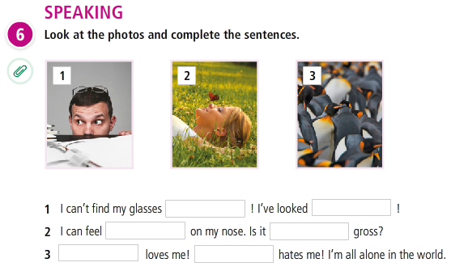


Slide 13
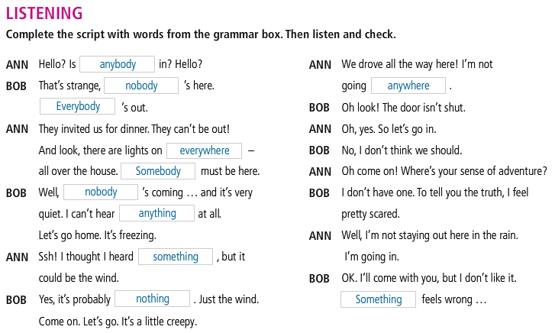
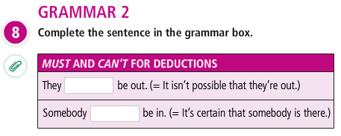
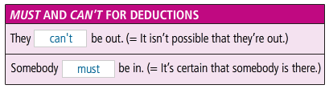

Slide 14
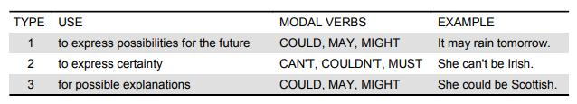
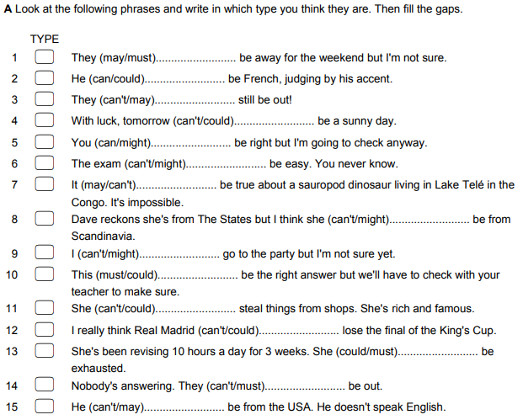
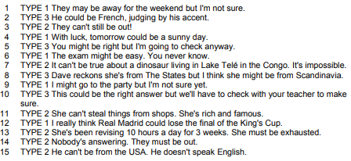
GRAMMAR
MODAL VERBS FOR DEDUCTION

Slide 15
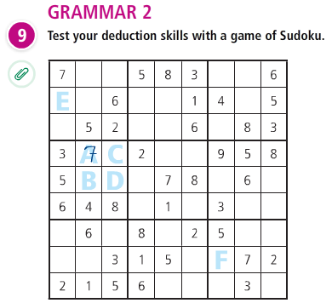

Slide 16
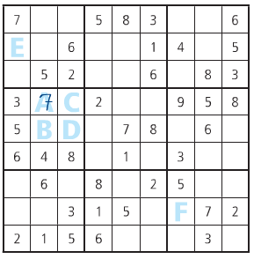
RESULTS OF GAME SUDOKU
A must be 7. At can’t be 3,5,6, 4 or 8 because they are in the same box, 1 is in the same column, and 2 and 9 are in the same row.

Slide 17
RESULTS OF GAME SUDOKU
C can’t be 2,3,5,7,8, or 9 because they are in the same row. C can’t be 4, 6 because they are in the same box. So it must be 1.

Slide 18
RESULTS OF GAME SUDOKU
D can’t be 1, or 2 because there is a 2 in that’s column. So D must be 9.

Slide 19
RESULTS OF GAME SUDOKU
B must be 2.

Slide 20
RESULTS OF GAME SUDOKU
E can’t be 1, or 4 or because they are in that row. E must be 8 or 9.

Slide 21
RESULTS OF GAME SUDOKU
F must be 6, or 8.

Slide 22
References
Grammar: Indefinite pronouns
https://www.youtube.com/watch?v=GFtDBGJIB5w
https://www.youtube.com/watch?v=g95WFsIfS40
https://www.youtube.com/watch?v=1uIHBOWrUic
https://www.youtube.com/watch?v=o9qs7jJfusM
Listening:
https://www.youtube.com/watch?v=0gAkJOYZKok

Slide 23
